Slide 1
TERM PAPER - AI
Topic :
Detection of COVID-19 Using Artificial Intelligence
Professor – ALMABROK ESSA
LEELA KRISHNA PRASAD KOTHARU
2814096

Slide 2
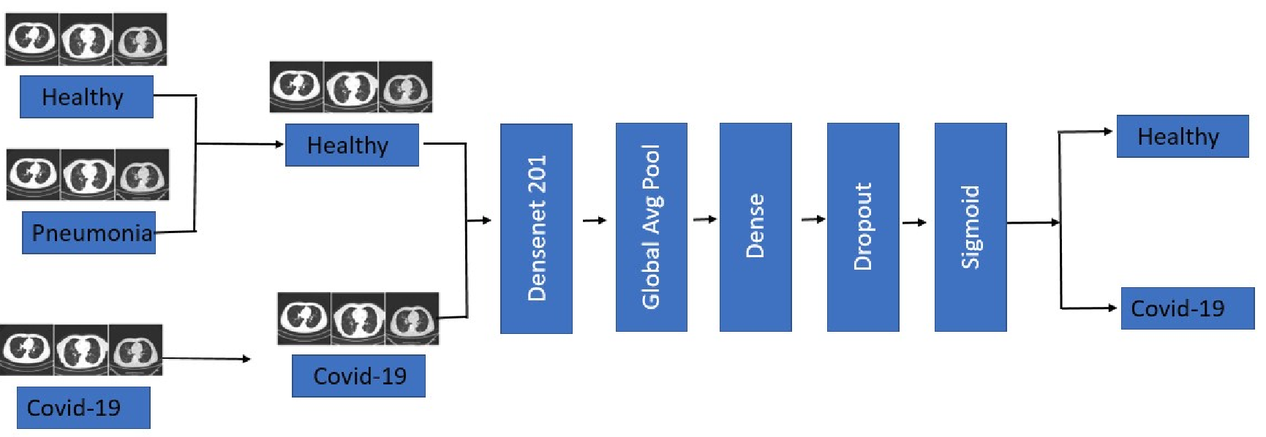
Outline
Introduction
Theoretical description
Data Collection and Modeling
Deep Learning Architecture
Hyper parameter selection
Results and Discussion
References

Slide 3
Introduction
The novel Coronavirus swept throughout the world
It’s an RNA virus that may afflict humans and animals alike.
A early recognition of the virus could help to limit and prevent a catastrophic COVID - 19 breakout.
Modern pharmalogical techniques and detecting methods such as:
Serology tests
Reverse transcription-polymerase chain reaction (RT-PCR)
These techniques are
Time-consuming
Costly
Need analysis in a well-equipped facility
limited and unavailable to everybody

Slide 4
Introduction
Developing a computer-aided warning system employing classification approach, which is an emerging artificial intelligence (AI) technique.
Deep Learning (DL) is a subset of Machine Learning (ML), which is therefore a domain of Artificial Intelligence (AI).
It derives characteristics from data (which may be in any format, such as image, text, or voice).
The aim is to learn directly from data.
Conventional neural networks include two or three hidden layers, but the most recent networks have 150 layers.[1]
Ref 1: Suzuki, K. (2017). Overview of deep learning in medical imaging. Radiological physics and technology, 10(3):257–273.

Slide 5
Introduction
This work investigates the background and problem automation of distinguishing COVID-19 infected patients from normal persons with chest CT scans.
Feature detection in computed tomography (CT scans) scans may be learned using convolutional neural networks (CNNs)
Convolutional Neural Network (CNN) is a Machine Learning Multi - layer perceptron that has shown to be extremely effective in content analysis, picture categorization, posture identification, and action recognition.
In the medical field, it also performs admirably.
As a result, CNN models may be utilised to produce superior image predictions. [1]
Ref 1: Suzuki, K. (2017). Overview of deep learning in medical imaging. Radiological physics and technology, 10(3):257–273.

Slide 6
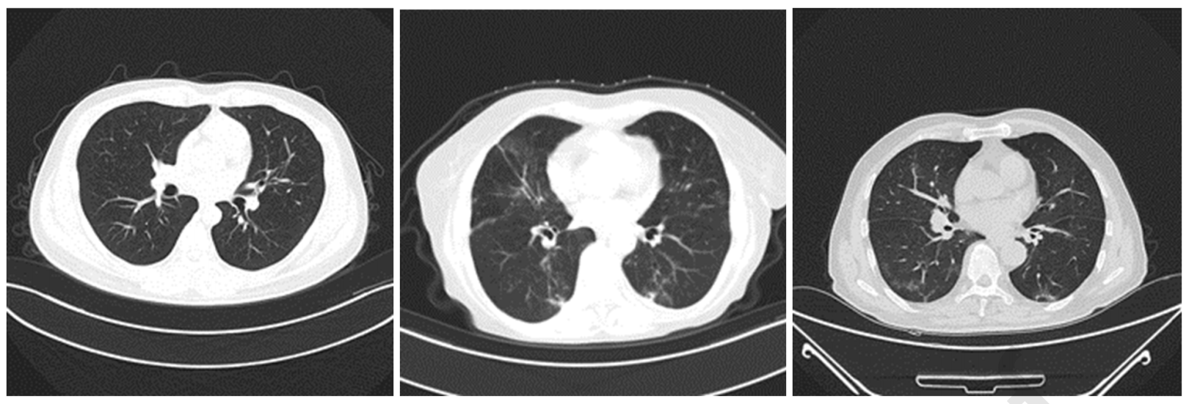
Theoretical description
Data Collection and Modeling
Deep Learning Architecture
Hyper parameter selection
Figure 1: CT-scan pictures as from training data set for all three classes as examples.

Slide 7
Data Collection and Modeling
COVIDx CT is a publicly available benchmarking data collection that includes 1,94,922 CT segments of 3,745 individuals
This data set is used to train, test, and evaluate our model
Data collection was made public in ’Kaggle.’A’ and ’B’ versions of COVIDx CT are available.
The’A’ variety includes cases with a verified diagnosis. Non-COVID-19 pneumonia and COVID-19 patients had irregularities on CT slices that were manually discovered by radiologists or non-radiologists
The ’B’ variety covers the complete ’A’ variant, as well as those cases that are suspected of being correctly identified but could not be verified.

Slide 8
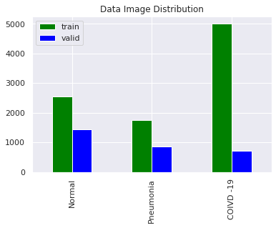
Data Collection and Modeling
Data is crucial in the creation of a CNN Model, and good amount of data training is required to achieve increased accuracy.
The training data is separated into two categories: NON-COVID and COVID
Data collection was made public in ’Kaggle.'A' and ’B’ versions of COVIDx CT are available.
The total amount of NON-COVID and COVID CT learning segments is made up of 10,000 pictures picked at random to maintain data neutrality, and 3000 images picked at random for validation.
Figure 1: Image data distribution.

Slide 9
Deep Learning Architecture
Convolutional Neural Networks (CNNs) are meant to integrate spatial feature layers via backpropagation employing a variety of important components such as convolution layers and fully connected layers.
The model classifies the data set into two groups: Covid and NONCOVID.
The model classifies the data set into two groups: Covid and NONCOVID. The model is comprised of five parts:
Data from non-COVID sources are grouped together.
Layers of input
Densenet-201 is the base model.
Layers that are fully connected yet have a dropout .
Output layer.

Slide 10
Deep Learning Architecture
Healthy
Non-covid-19
Non-covid-19
Dense
Sigmoid
Densenet 201
Global Avg Pool
Dropout
Pneumonia
Covid-19
Covid-19
Covid-19

Slide 11
Hyper parameter selection
To guarantee the data neutrality, the data was divided into two main groups: NON-COVID and COVID, with 10,000 photos randomly selected.
The information was split into 32 batches
65 epochs were totalled
The training rate was set at 0.0001 for the first 40 epochs, then increased by a factor of ten for the next 25 epochs.
The TensorFlow library was used to develop, train, and assess the model.

Slide 12
Results and Discussion
The accuracy of the DenseNet-201 framework in classifying NON-COVID and COVID CT segments was percent in the proposed CNN model.
Other categorization metrics are calculated depending on the possible outcomes of Confusion Matrix’s test cases
Four principal outcomes of the confusion matrix:
True Positive (TP)
True Negative (TN)
False Positive (FPFPFP)
False Negative (FN)
TP denotes occurrences in which the model accurately anticipated positive outcomes.
TN denotes cases in which the model correctly predicted negative outcomes
The TensorFlow library was used to develop, train, and assess the model.

Slide 13
Results and Discussion
TP denotes occurrences in which the model accurately anticipated positive outcomes.
TN denotes cases in which the model correctly predicted negative outcomes
FP signifies cases in which the model predicts a positive result but the outcome is really negative.
FN denotes cases in which the model identifies a negative result but the outcome is clearly positive.
The ratio of genuine true positives prediction to total actual positive values is known as the Positive Predictive Value (PPV).
Accuracy is defined as the proportion of accurate predictions made to actual predictions made.
The Sensitivity or Recall of a prediction indicates how many of the actual predictions are correctly classified

Slide 14
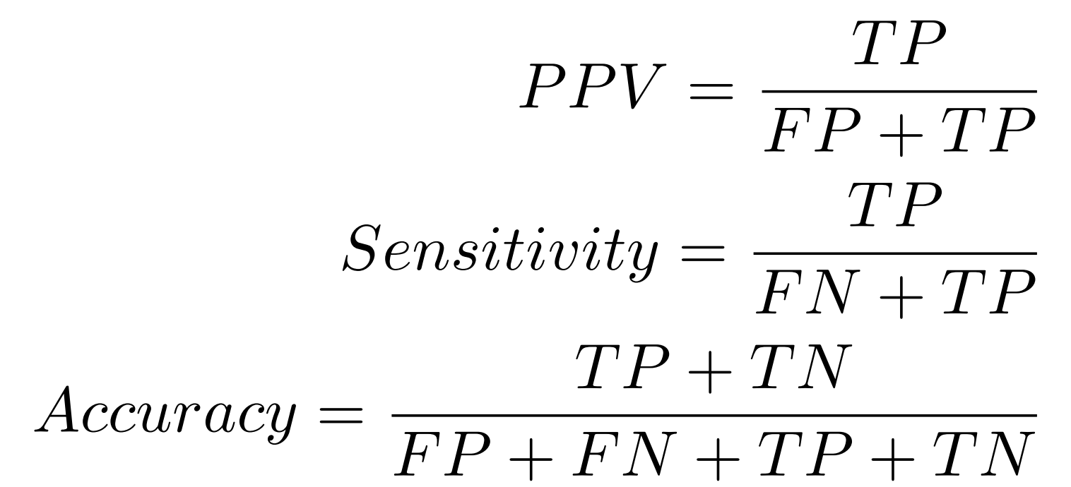
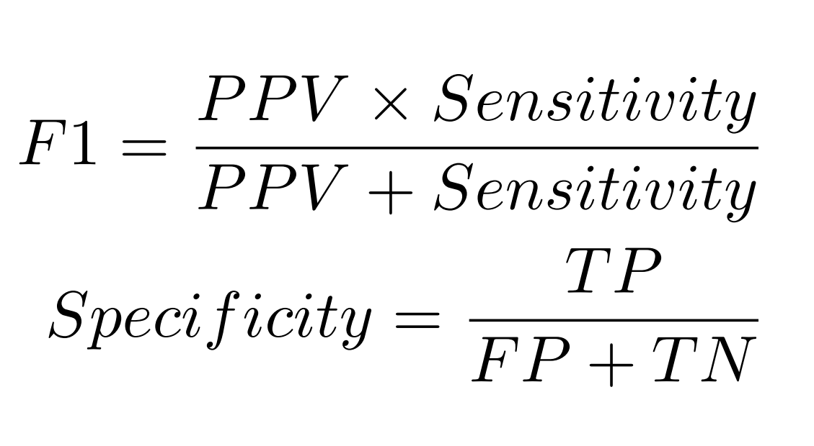
Results and Discussion
High sensitivity implies few false negatives, resulting in missed patients with COVID-19 infections
High PPV implies few false positives.
The ratio of true negatives to the total number of negatives is known as Specificity.
It represents the cases in which the model expected a negative outcome when it was actually a negative outcome.
The F1-Score is a blend of precision and sensitivity, with equal weightage for both metrics.

Slide 15
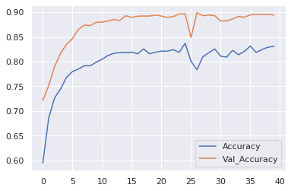
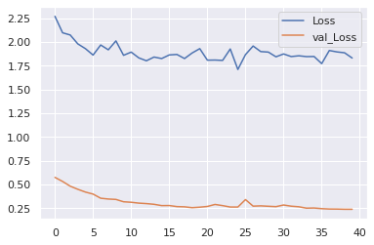
Results and Discussion
Fig: Model Accuracy vs Epochs
Fig: Model Loss vs Epochs

Slide 16
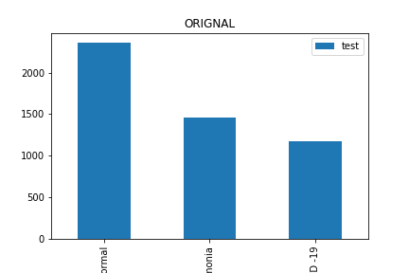
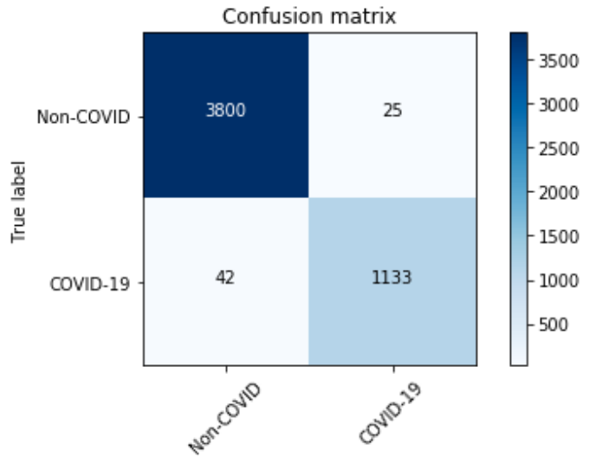
Results and Discussion
Fig: Confusion matrix
Fig: Test data distribution

Slide 17
References
https://www.ncbi.nlm.nih.gov/pmc/articles/PMC7605758/
https://pubmed.ncbi.nlm.nih.gov/32834641/
https://www.sciencedirect.com/science/article/pii/S235291482100191X
https://healthcaresummit.ieee.org/wp-content/uploads/sites/362/2021/08/MOSMEDDATA_CHEST-CT-SCANS-WITH-COVID-19-RELATED-FINDINGS-DATASET.pdf
https://web.hku.hk/~gyin/materials/2020LiuGaoHeLiuYinKDD.pdf

Slide 18
THANK YOU
(Any Queries?)

